Slide 1



Home
About
Hotels
Rooms
Contact
Hamro Booking Sewa
Start searching for your hotel room
Laxman Parajuli
Sandhya Banstola
Ujjwal Adhikari

Slide 2

Hamro Booking Sewa
Home
About
Hotels
Rooms
Contact
Introduction
Hamro Booking Sewa is a laravel and react native based android application project on online hotel booking where users can view, select and book hotel.
The project has different modules in the development work, which are divided among super admin, hotel owners, customers, and search option

Slide 3
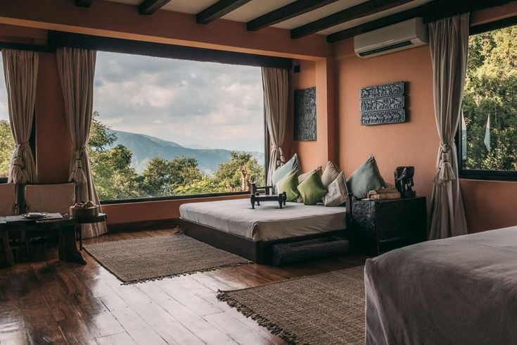
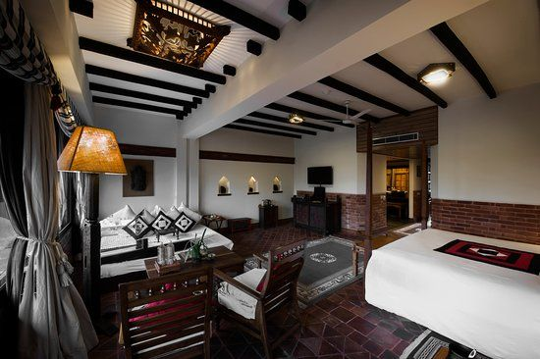
Hamro Booking Sewa
Home
About
Hotels
Rooms
Contact
Completed
01. Fetch data from laravel in mobile app in JSon format
02. Sections for hotel and hotel rooms created in backend

Slide 4
Hotel Booking Sewa
Home
About
Hotels
Rooms
Contact
Needs To Be Done
01.
02.
03.
Multi level authentication using laravel
Handling Post Method APIS
Booking Confirmation

Slide 5
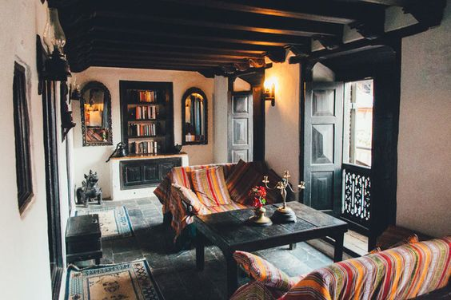
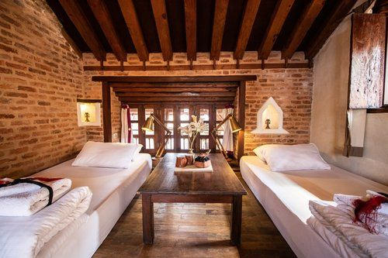
Hamro Booking Sewa
Home
About
Hotels
Rooms
Contact
Bottlenecks
01. API Integration
02. Fetching Pictures in JSon Format
03. Manipulation of Multiple Pictures

Slide 6

Hamro Booking Sewa
Home
About
Hotels
Rooms
Contact
Navigation
Home
About
Hotels
Rooms
Contact
Thank You

